Slide 1
Observability Tools for
Multi-Agentic Engineering Auditability
A vendor-independent comparison for regulated enterprises
Covering AWS, Azure, GCP, and open-source stacks
Associate Director, GenAI Products — Novartis
MLDS 2026 · 27 March 2026

Slide 2
Why This Matters for Regulated Industries
In pharma/GxP, every automated decision must be documented, traceable, and reproducible — by regulation.
GxP Compliance
Every agent decision affecting clinical data requires documented provenance
EU AI Act (Article 14)
High-risk AI systems must maintain comprehensive audit trails
21 CFR Part 11
Electronic records require integrity, attribution, and traceability
ICH E6(R3)
Computerized systems in clinical trials must be validated and auditable
MLDS 2026 · Observability Tools for Multi-Agentic Auditability · 2/16

Slide 3
Evaluation Criteria — What We Tested
Deep Agent Tracing
Full span hierarchy — agent, tool, LLM — not just API call logs
Swarm / Multi-Agent Audit
Consensus votes, peer messages, handoff metadata captured?
Evaluation Pipeline
Quality scores linked to trace spans, not just aggregate dashboards
Forensic Replay
Deterministic re-execution from checkpoints after failures
Identity & Governance
Agent identity, least-privilege scoping, delegation chain audit
OTel / Standards
OpenTelemetry GenAI semantic conventions — portable, future-proof
MLDS 2026 · Observability Tools for Multi-Agentic Auditability · 3/16

Slide 4
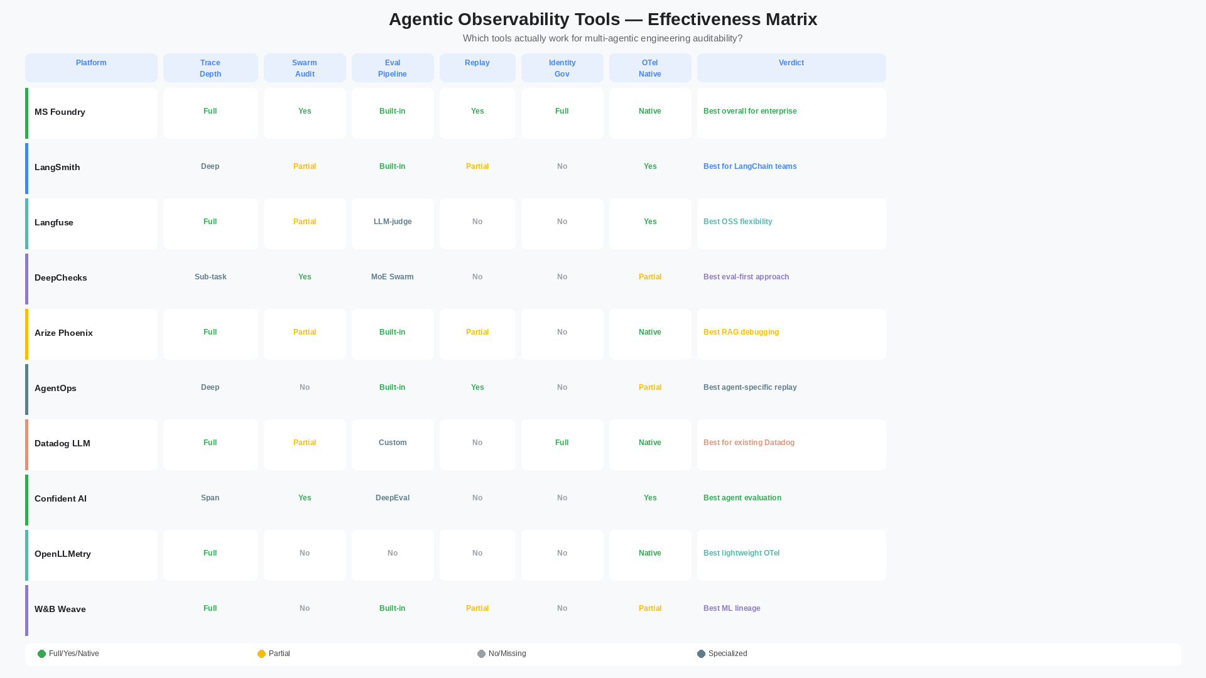
Effectiveness Matrix — 12 Platforms Compared
MLDS 2026 · Observability Tools for Multi-Agentic Auditability · 4/16

Slide 5
AWS Stack — Bedrock AgentCore
2M+ SDK downloads since preview. OTel-native. CloudWatch GenAI observability dashboards.
AgentCore Observability
AgentCore Evaluations
Session/trace/span hierarchy. CloudWatch GenAI dashboards.
Built-in + custom evaluators. Online eval. CloudWatch Alarms.
AgentCore Policy (GA)
OTel Integration
Permission boundaries, guardrails. Least-privilege per agent.
ADOT SDK. W3C + X-Ray format. Exports to Datadog, Arize, LangSmith.
MLDS 2026 · Observability Tools for Multi-Agentic Auditability · 5/16

Slide 6
Azure Stack — Microsoft Foundry
GA March 2026. Auto-instrumentation. Evaluations + tracing + monitoring in one control plane.
Auto-Instrumentation
Continuous Evaluation
Zero-code tracing for Semantic Kernel, LangChain, LangGraph, OpenAI Agents SDK.
Built-in + custom (Python/LLM-judge). Eval linked to traces. Agent monitoring dashboard.
Azure Monitor Integration
OTel + W3C Trace Context
No separate silo. AI telemetry into existing dashboards, RBAC, alerts. Grafana compatible.
MS + Cisco co-authored multi-agent OTel conventions. Framework-agnostic by design.
MLDS 2026 · Observability Tools for Multi-Agentic Auditability · 6/16

Slide 7
Open-Source & Vendor-Neutral Tools
Langfuse
MIT OSS. 6M+ installs/month. Self-host for data sovereignty. Best OSS LLMOps platform.
Arize Phoenix
OSS, OTel-native. RAG debugging, drift detection. Upgrade path to Arize AX enterprise.
OpenLLMetry / Traceloop
Lightweight OTel-native. Hub + MCP server. Works with Prometheus/Grafana/Jaeger.
DeepChecks
SLM swarm + MoE. Evaluates agents with agents. VPC/on-prem/bare-metal. CI/CD integration.
MLDS 2026 · Observability Tools for Multi-Agentic Auditability · 7/16

Slide 8
Framework-Specific Tools
LangSmith
Proprietary SaaS. Near-zero overhead. Time-travel debugging. Best for LangChain/LangGraph teams.
AgentOps
Agent-specific monitoring. Session replay. Multi-agent workflow visualization. Python-only, cloud-only.
Confident AI + DeepEval
50+ research-backed metrics. Span-level eval. Graph visualization. Red teaming. OSS core.
W&B Weave
@weave.op decorator. Trace-rich eval with ML lineage. Best for ML-heritage teams with experiment tracking.
MLDS 2026 · Observability Tools for Multi-Agentic Auditability · 8/16

Slide 9
Enterprise APM — Extended for AI
Datadog LLM Observability
Extends existing APM. Native OTel. Cross-stack correlation. LLM-specific dashboards. Best for Datadog shops.
Dynatrace Davis AI
Behavioral telemetry. Auto-instrumentation. AWS/Azure/GCP integrations. Causal AI for root cause analysis.
Elastic Observability
AgentCore integration. OTel ingestion. Agent Builder for SRE. Full-text search on traces. APM + AI unified.
New Relic AI Monitoring
GenAI monitoring module. Token tracking, cost analytics, performance dashboards. Familiar for existing NR teams.
MLDS 2026 · Observability Tools for Multi-Agentic Auditability · 9/16

Slide 10
Head-to-Head Comparison
Platform | Trace | Swarm | Eval | Replay | OTel
AWS AgentCore | Full | Partial | Built-in | Partial | Native
Azure Foundry | Full | Yes | Built-in | Yes | Native
LangSmith | Deep | Partial | Built-in | Partial | Yes
Langfuse | Full | Partial | LLM-judge | No | Yes
DeepChecks | Sub-task | Yes | MoE | No | Partial
Arize Phoenix | Full | Partial | Built-in | Partial | Native
Datadog LLM | Full | Partial | Custom | No | Native
AgentOps | Deep | No | Built-in | Yes | Partial
MLDS 2026 · Observability Tools for Multi-Agentic Auditability · 10/16

Slide 11
Decision Framework — For Regulated Enterprises
AWS-native + Bedrock agents?
->
AgentCore + CloudWatch
Azure-native + compliance?
->
Foundry + DeepChecks
Multi-cloud + data sovereignty?
->
Langfuse + Arize Phoenix
Evaluation-first + GxP?
->
DeepChecks + Confident AI
Existing APM (Datadog/Elastic)?
->
Extend with LLM module
Maximum portability?
->
OTel + OpenLLMetry + Grafana
MLDS 2026 · Observability Tools for Multi-Agentic Auditability · 11/16

Slide 12
Latency Overhead Benchmark
Measured on 100 identical multi-agent queries (multi-step travel planning)
LangSmith
~0%
Lightest trace artifacts. Best runtime performance.
AWS AgentCore
~2%
Auto-instrumented. CloudWatch native. Minimal overhead.
Laminar
~5%
No inline evaluation. Clean integration path.
AgentOps
~12%
Decoupled integration adds per-step latency.
Langfuse
~15%
Richer trace detail = more I/O per request.
DeepChecks
Async
Evaluation runs async. Zero runtime overhead.
MLDS 2026 · Observability Tools for Multi-Agentic Auditability · 12/16

Slide 13
Recommendations for Pharma / GxP
Clinical Workflows
Azure Foundry or AWS AgentCore for managed compliance. DeepChecks for eval. Langfuse for self-hosted audit.
Commercial Analytics
Langfuse + Arize Phoenix (multi-cloud). LangSmith if LangChain-native. Datadog if existing stack.
Regulatory Submissions
DeepChecks MoE for evaluation accuracy. Foundry/AgentCore for identity governance. OTel for portability.
Internal AI Platforms
OpenLLMetry + Grafana for lightweight start. Migrate to Arize AX or Foundry for enterprise scale.
MLDS 2026 · Observability Tools for Multi-Agentic Auditability · 13/16

Slide 14
Key References
1. AWS Bedrock AgentCore Observability (OTel + CloudWatch GenAI)
2. Azure Foundry Observability (GA March 2026)
3. DeepChecks Agentic Workflow Evaluation (MoE + CI/CD)
4. OpenTelemetry GenAI Semantic Conventions (agent spans)
5. Langfuse Open-Source LLMOps (MIT, self-hosted)
6. Arize Phoenix + AX (OSS + enterprise upgrade path)
7. AIMultiple: 15 AI Agent Observability Tools Benchmarked
MLDS 2026 · Observability Tools for Multi-Agentic Auditability · 14/16

Slide 15
Key Takeaways
01
No single tool covers all 6 auditability dimensions — plan a 2-3 tool stack
02
AWS AgentCore and Azure Foundry are now production-grade for regulated use
03
DeepChecks MoE fills the evaluation gap that trace-only tools miss
04
OTel-native tools ensure portability across clouds — critical for pharma
05
Start with one workflow, instrument it fully, then scale across the org
MLDS 2026 · Observability Tools for Multi-Agentic Auditability · 15/16

Slide 16
The best observability stack
is the one that makes every agent decision
forensically reconstructable.
Choose tools that serve your compliance requirements first,
your engineering workflow second.
Thank You — MLDS 2026

